Slide 1
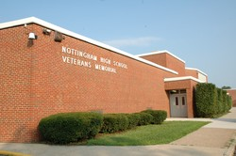
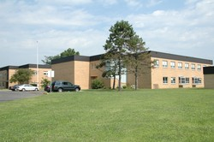
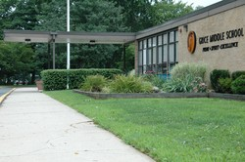
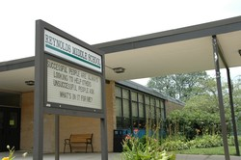
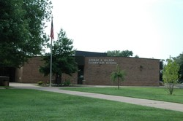
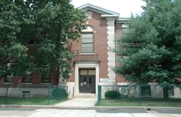
Presentation of Learning
June 30, 2011
Linda Bedford
Lauren Goldstein
Jennifer Magdelinskas

Slide 2
Our Phase II
Working in grade-level teams, using a lesson plan format developed by the PLC, we developed a series of K-12 lessons to teach about the flow of energy.

Slide 3
Phase II Goals
Vertical Articulation to develop connections between content taught in each grade
Deeper content knowledge for the teachers in order to facilitate instruction
Instruction via inquiry-based lessons and Big Idea Thinking
Awareness of our place in the scaffolding process

Slide 4
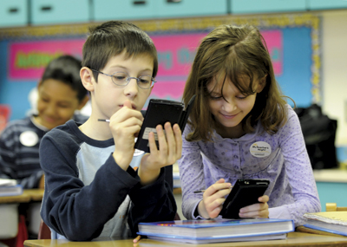
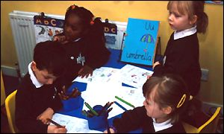
We learned …
From each other
The Tuning Protocol enabled our PLC to effectively evaluate each team’s lessons providing warm and cool feedback in a safe environment.
Supported each others’ learning and development of depth of content knowledge.

Slide 5
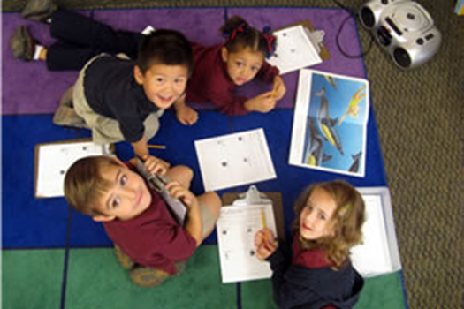
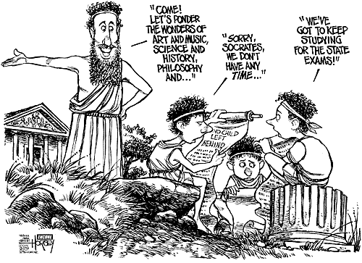
We learned …
Inquiry is an effective tool in the classroom.
To be comfortable using inquiry in the classroom, a result of courage, persistence, and colleague support.
Tests are not the only type of assessment. There is more than one way to assess learning.

Slide 6
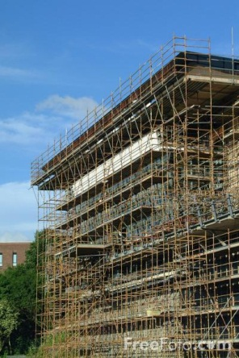
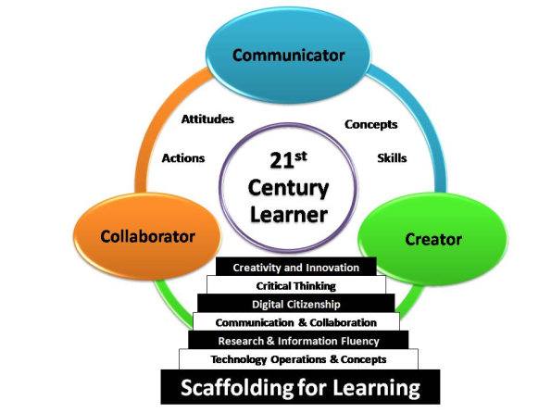
Our Successes
Critiqued/evaluated and completed development of K-12 inquiry-based lessons about the flow of energy. The evaluation process provided an opportunity for critical feedback and professional sharing from which we all grew as teachers. These new understandings led to new inquiry learning experiences for our students.
A greater understanding of what our students have been taught and what they need to know the next year enables us as teachers to hold the students accountable for prior learning and to facilitate the development of a solid knowledge base on which they will build in the future.

Slide 7
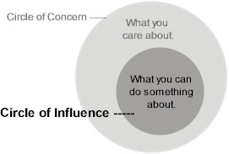
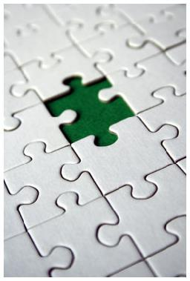
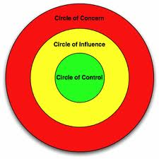
Tasks Not Completed
Due to lack of interest, we did not present our PLC experiences and the products of our work to our colleagues outside of the PLC.

Slide 8
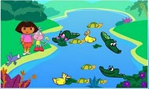
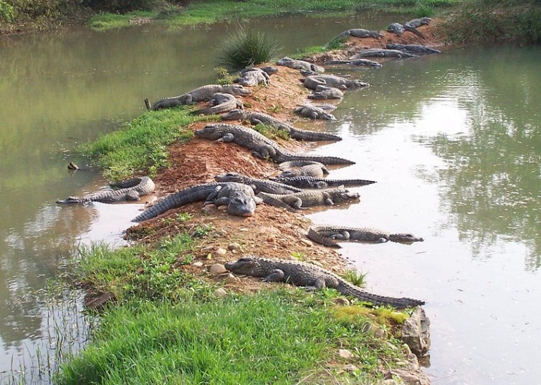
Our Obstacles and How We Overcame Them
Meeting attendance - addressed by planning a year’s worth of meetings in advance.
Our next focus - polled PLC members for their interests and needs, and then collectively chose a direction based on common interests.

Slide 9
What we wish we had done differently
We wish we could have had the opportunity to share out work with our colleagues outside our PLC. Perhaps we needed a better method of “advertising” ourselves (making our work seem relevant).

Slide 10
CONNECT-ED imprinted itself on us by changing the way we teach, and impacted our students by changing the way they learn.

Slide 11
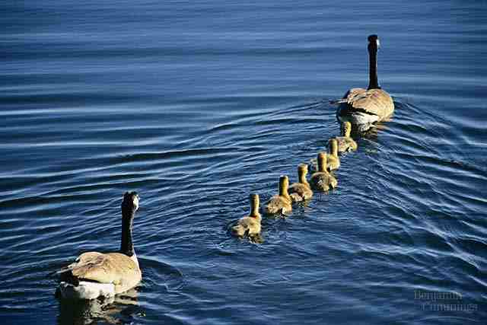
Imprint – to change indelibly, or permanently
We allow our students to explore more. This has changed how we teach the content. The order in which we assign learning tasks has changed to allow students to construct their own knowledge.

Slide 12
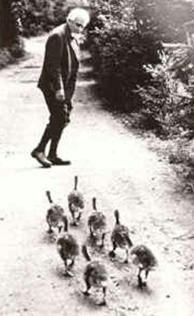
Imprint – to change indelibly or permanently
We are less controlling in the classroom.
We allow more student exploration.
We give our students the freedom to design labs (as grade-level appropriate).

Slide 13
Impact – to have a direct effect (on others)
We have raised the standards for our students.
Students became active learners.
Increased ownership resulted in increased student interest and excitement to learn.
What is our evidence?
Improved student behavior, increased student participation, improved grades/performance on assessments

Slide 14
Next Steps

Slide 15
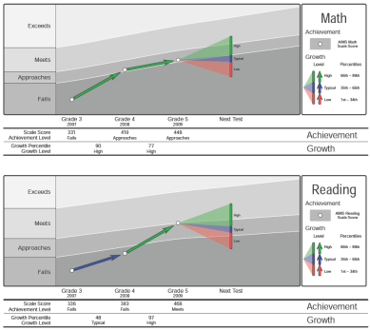
Our Next Steps
Continue with core PLC group and replace the few unable to continue to participate.
For now, we choose to keep our group small, working for improvement in our classrooms, where we can influence change.
Our next focus: To develop strategies/methods to show evidence of student growth/learning while maintaining a focus on inquiry-based instruction.
Develop assessments that generate concrete data/evidence of student learning.

