Slide 1
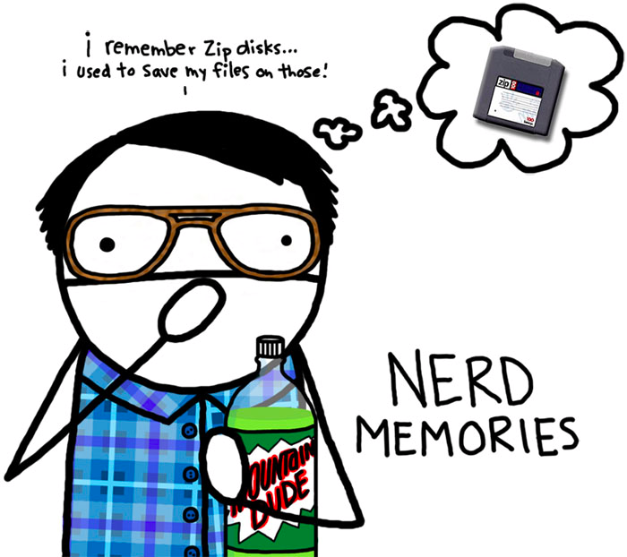
South Brunswick
Presentation of Learning- CONNECT-ED
Summer 2011
AKA… “Nerdy” Reflections

Slide 2
District Priorities
To enhance student learning through
increased depth of teacher science content knowledge
promotion of curriculum coherency and develop curriculum maps
fostering of inquiry instruction in our K-5 classrooms
Notes:
Stacey
When evaluating where we wanted to go with our Connect-Ed goals, these District Priorities came through

Slide 3
PLC 3-Year Goals
Create a Science PLC that will develop curriculum, district science professional development, and analyze student data
To increase elementary science teachers’ content knowledge to promote comfort and skill in teaching science
Notes:
Stacey We had 4 main C-E 3 year goals.

Slide 4
PLC 3-Year Goals
To develop a coherent K-12 Science curriculum that uses Big Idea Thinking, Understanding by Design, vertical articulation, and the 2009 science standards
To create a Curriculum Map for each unit in the K-12 curriculum, connecting concepts across grade levels
Notes:
Stacey

Slide 5
Goal 1
PLC Development
Goal 2
Content Knowledge
Goals 3 & 4
Curriculum & Mapping
CONNECT-ED
Leadership Training
at Rider
Survey
Data
Collection
Standards
Analysis
Data
Analysis
Session
Curriculum
Revision
Feedback
Forum
PLC Book
Study
Content
Training
Curriculum
Mapping
PLC
Quarterly
Meetings
Mini-BIM
Development
Coherent Curriculum and Confident Teachers with a conceptual understanding of connections in science
Notes:
Stacey As we worked through our ideas, we found that there were natural connections between our activities that helped support one and the next steps. We created this graphic to help us remember to build upon the activities and take advantage of the natural connections inherent in them.

Slide 6
Thinking About the Past
What did we learn?
What do we count as our successes?
What could we have done differently
What did we not complete?
What obstacles did we encounter?

Slide 7
Goal 1
PLC Development
Goal 2
Content Knowledge
Goals 3 & 4
Curriculum & Mapping
CONNECT-ED
Leadership Training
at Rider
Survey
Data
Collection
Survey
Standards
Analysis
Curriculum
Revision
Data
Analysis
Session
Curriculum
Revision
Feedback
Forum
PLC Book
Study
Curriculum
Mapping
Content
Training
Curriculum
Mapping
Content
Training
PLC
Quarterly
Meetings
Mini-BIM
Development
Coherent Curriculum and Confident Teachers with a conceptual understanding of connections in science
Notes:
Stacey As we worked through our ideas, we found that there were natural connections between our activities that helped support one and the next steps. We created this graphic to help us remember to build upon the activities and take advantage of the natural connections inherent in them.

Slide 8
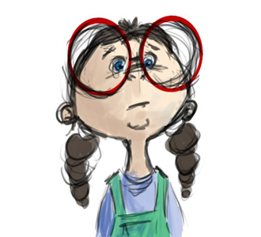
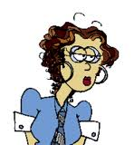
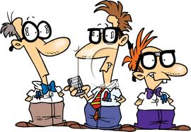
IMPACT of CONNECT-ED Work
Students:
Cohesive K-12 curriculum with less overlap, more in-depth learning, and an inquiry/problem-based approach.
Assessments now performance based and address the higher level of Bloom’s Taxonomy.
Teachers:
New found comfort within curriculum and content.
New resources and tools at teachers disposal.
District:
Standardization of objectives and essential questions.
Vertical articulation between grade levels and schools.
Notes:
Aparna

Slide 9
IMPRINT- How are we different from this experience?
BIT (Big Idea Thinking)- This has become our natural approach to teaching, learning, and working together.
Communication- We aim to establish productive and meaningful communication through protocols and norms. (teacher to student and teacher to teacher)
Mindfulness- We will always
aspire to think “nerdy” and
encourage our colleagues to do
the same.
Notes:
Janet

Slide 10
Envisioning the Future
Notes:
Aparna & Int dance

