Slide 1
Axiom Budget Planning File User Guide
Department of Financial Planning & Budget
January 2019

Slide 2
Axiom Budget Plan File User Guide
Axiom Software by KaufmanHall is the tool that is used to aid in the new fiscal year budget planning process. Assigned users from each division and college are assigned a role and each role plays an important part of the budget planning process. This guide will provide a step by step process to complete the planning file process.

Slide 3
Roles Defined
Budget Submitter
Is the first user to receive the plan file via email link.
Reallocates funds within organizations
Submits plan file to department budget approver
Budget Approver Role
Receives plan file via email link from budget submitter.
Reviews budget plan file and reallocations.
Approves & submits budget plan file to budget office (Non-Provost).
Approves & submits budget plan file to Provost office (Provost).

Slide 4
Axiom Plan File Distribution
The budget submitter will receive an email containing a link to the budget planning file to begin. To open the Axiom budget planning file, simply click on the link embedded in the email highlighted in blue.

Slide 5
Launching Budget Plan File Homepage
Clicking the embedded link launches your personal Axiom home page.

Slide 6
Axiom Homepage
The Axiom Homepage:
Indicates the Organization assigned to you.
Includes instructions detailing how to proceed with the budget planning file.
Includes the Operating Plan (Budgeting) tab where you will proceed with budget reallocations.
Directs you to contacts if questions should arise.

Slide 7
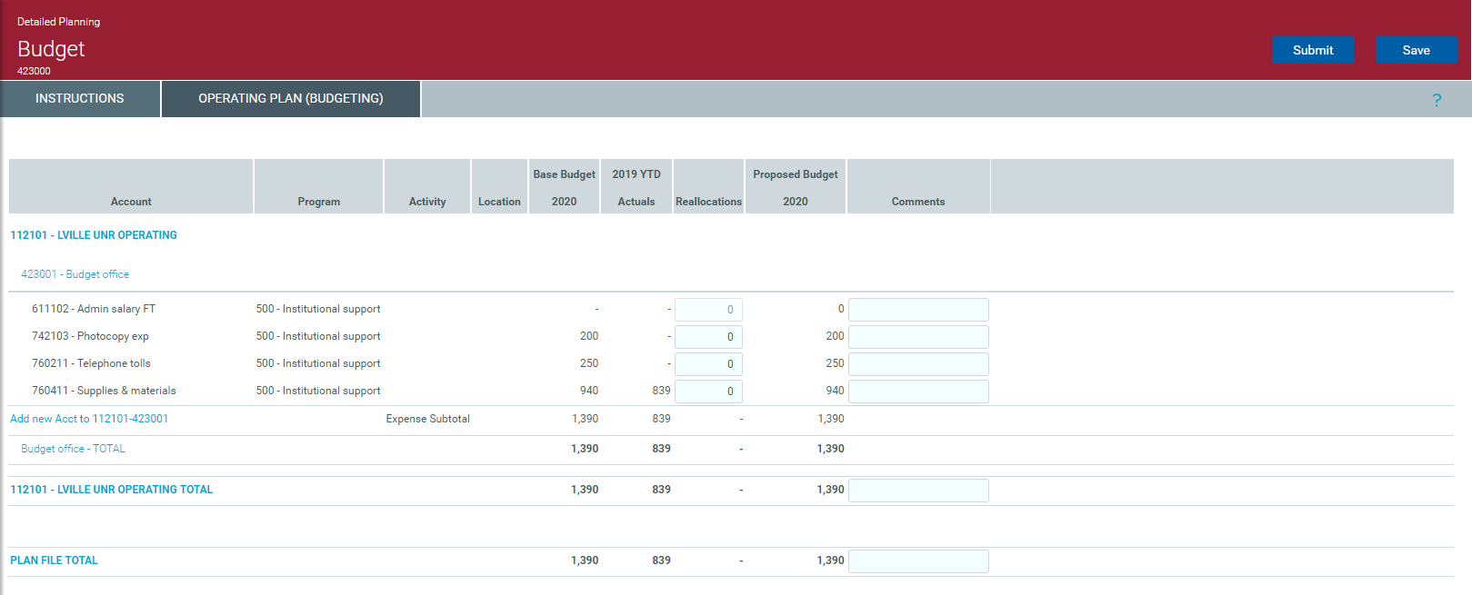
Operating Plan (Budgeting)
Click on the Operating Plan (Budgeting) tab to begin reallocating budget.

Slide 8
Budget Fields Defined
Base Budget 2020: This is the base operating budget for FY2020. The amounts in this column cannot be changed.
2019 YTD Actuals: Actual amount spent per account code is listed here. These amounts cannot be changed.
Reallocations: Highlighted blue cell indicating changes can be made by the user.
Proposed Budget 2020: New FY2020 base budget after reallocations.
Comments: Required when moving funds between organizations.

Slide 9
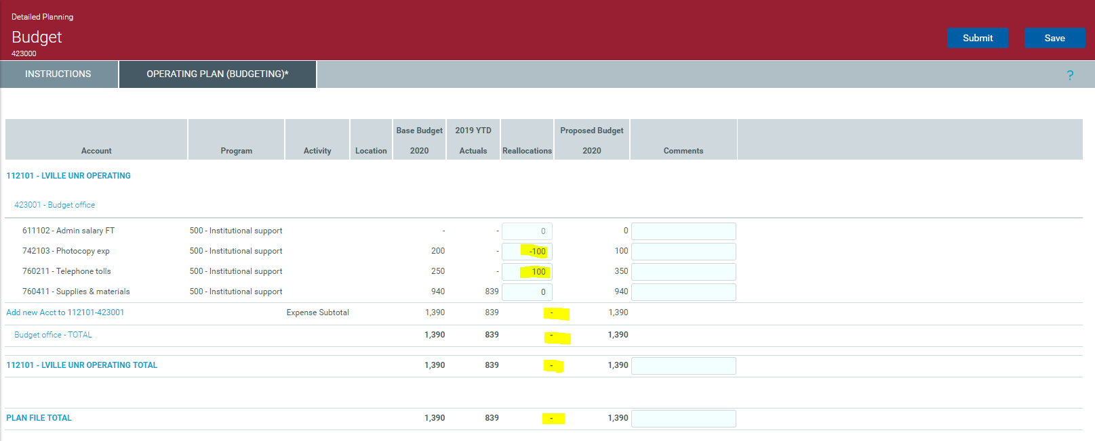
Reallocating Budget within Organization
To reallocate funds within the same org, tab into the blue cells to reflect the change. The sum of the change must net zero.

Slide 10
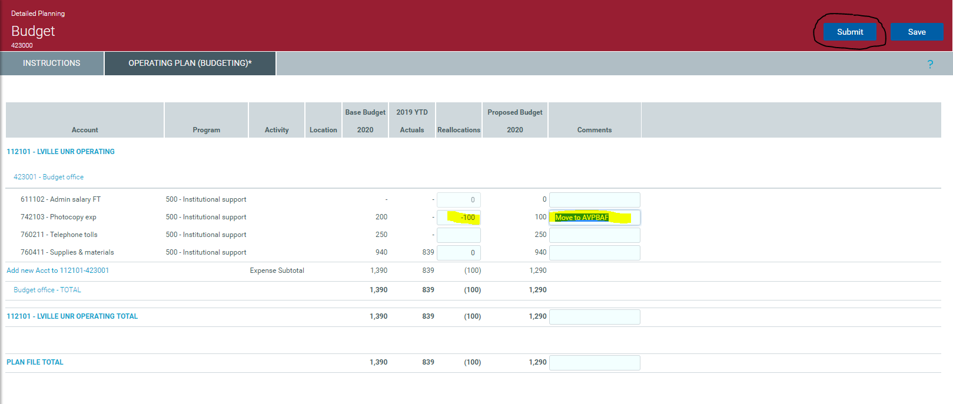
Reallocating Budget to Another Organization
To reallocate funds from one organization code to another, a comment is required for the funds to be reallocated to the correct organization.

Slide 11
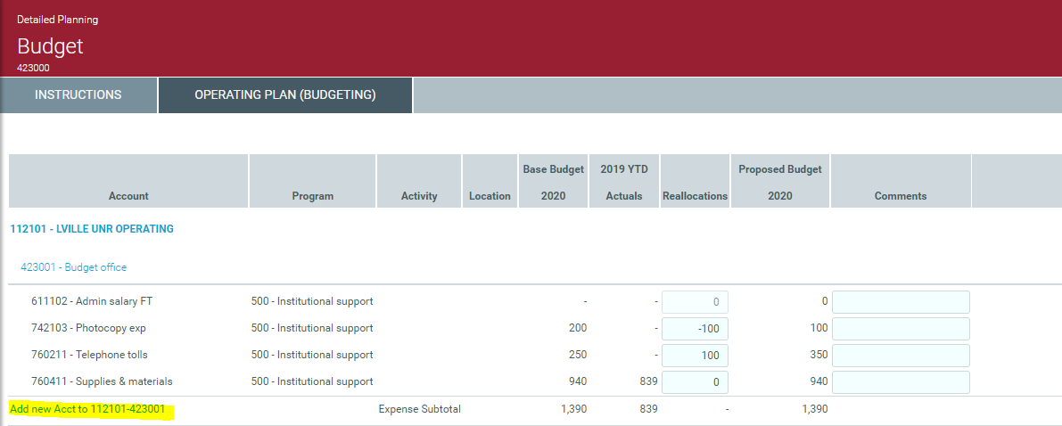
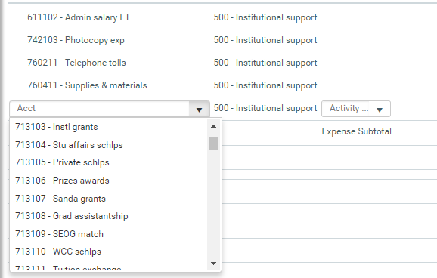
Adding Account Code to Reallocate Funds
Looking for an account code but don’t see it? You can add it here to your organization by clicking Add New Acct to and select from drop down.

Slide 12
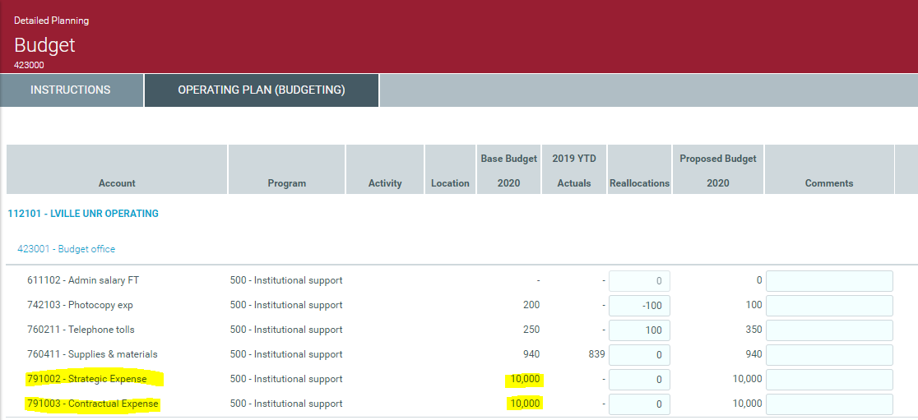
Reallocating Approved Budget Increases
Any approved Strategic or Contractual increases will be incorporated into the Base Budget 2020. It is important to note that these funds MUST be reallocated as the account codes are place holders only.

Slide 13
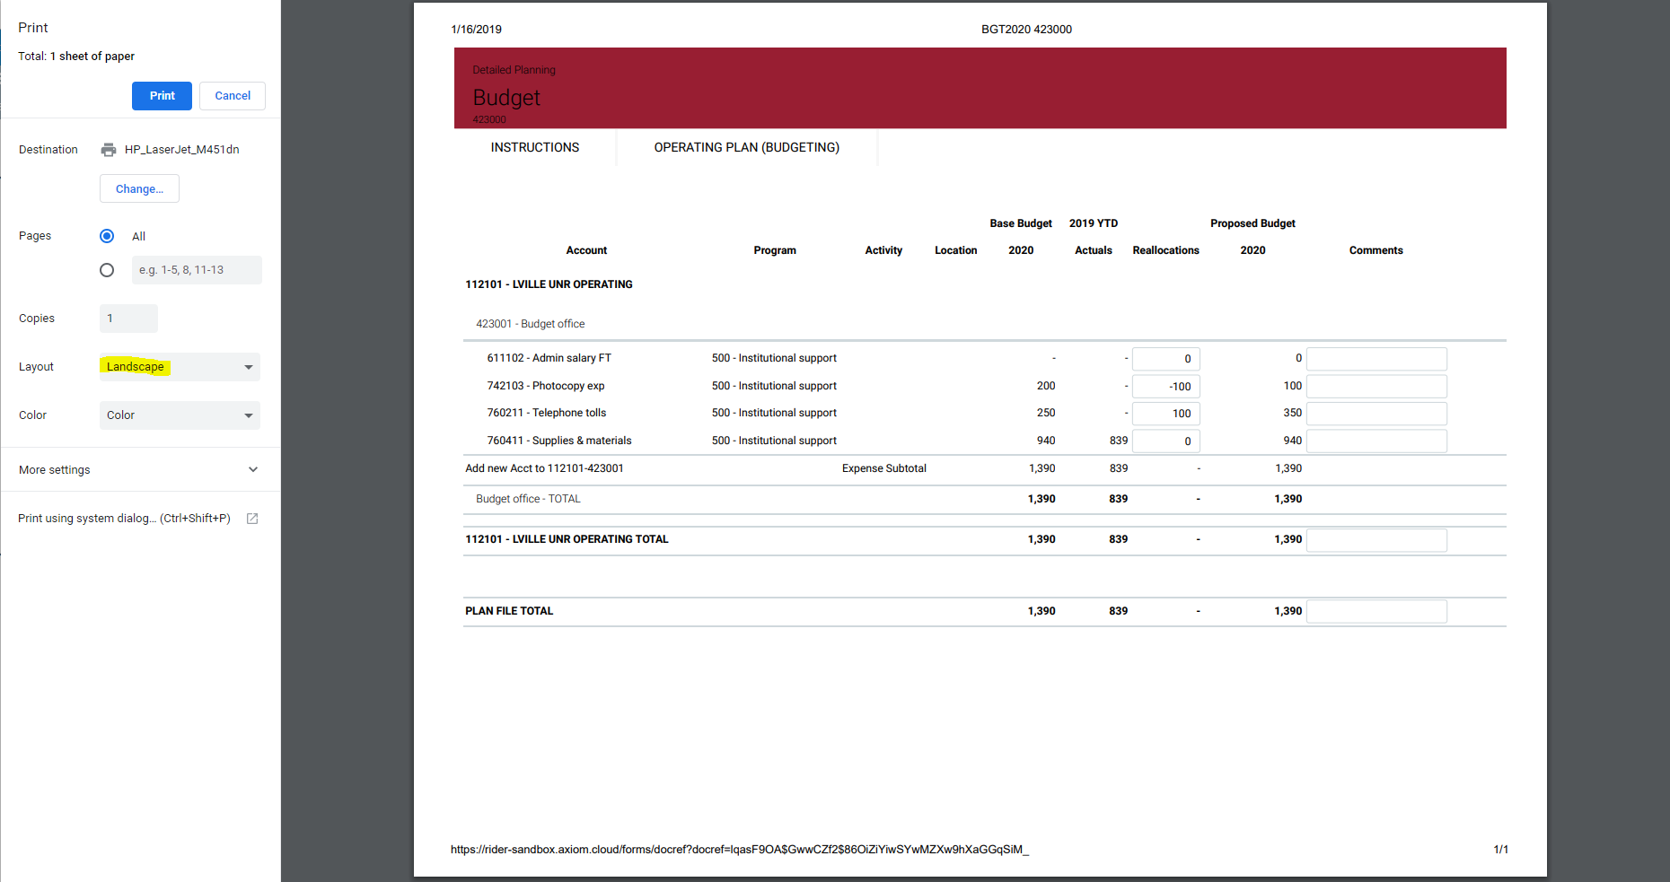
Submitting Reallocations
Print using the ellipsis on the upper right corner. View access only is available until the budget cycle is closed.

Slide 14
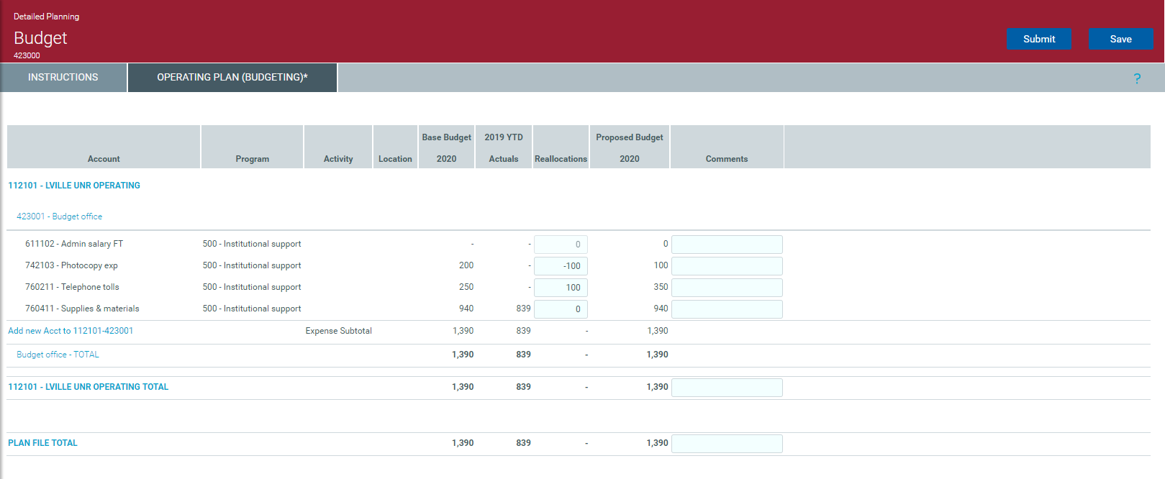
Submitting the Budget Planning File
When reallocations are completed, either SAVE or SUBMIT. Once you submit, you will have view access only of the planning file.

Slide 15
View Plan File After Submitting
Once you select the SUBMIT button, you will have view access only of the planning file. Even though you can see the SAVE button it is deactivated. Reactivating this screen requires the Budget Approver to reject the planning file, sending back to the submitter for changes.

Slide 16
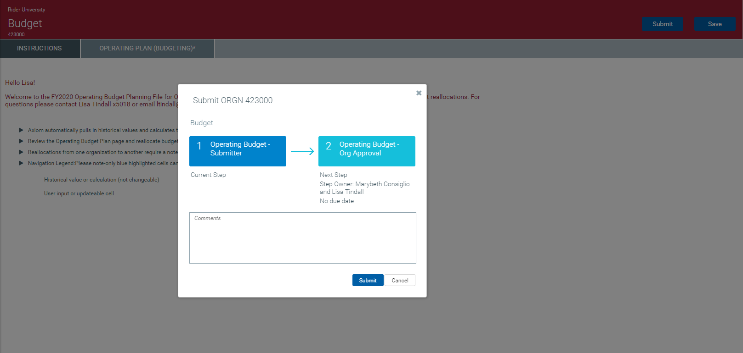
After Planning File submission
When the planning file is submitted, the following notification will pop up showing the flow of the planning file. The comment section can be used to send a note to the next step owner. Then hit submit.

Slide 17
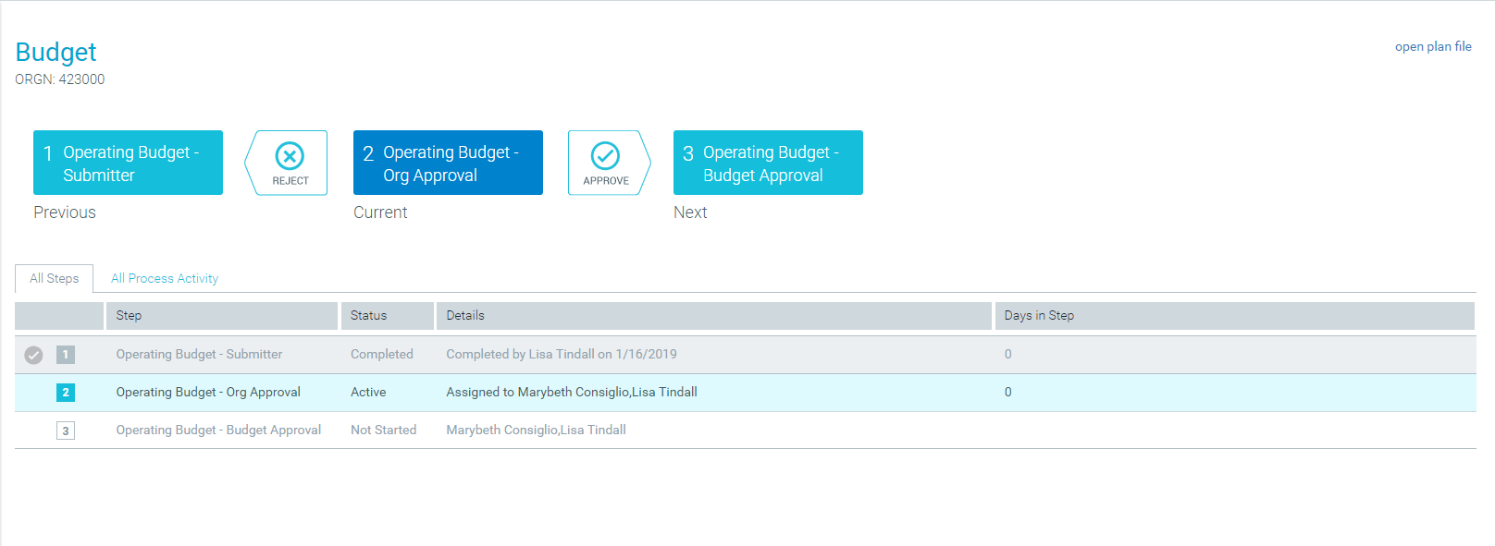
After Planning File Submission
Once the planning file is submitted, Axiom will return another flow chart showing the next steps in the life of the planning file.

Slide 18
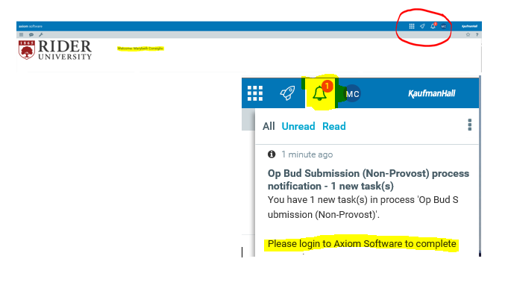
Budget Approver
After the Budget Submitter SUBMITS the planning file, the Budget Approver will receive both an email and Axiom notification.

Slide 19
Budget Approver
The Budget Approver can do the following:
Reject – Routes plan file back to the submitter to make adjustments.
Submit (Non-Provost) – Routes FINAL plan file to the Budget Office.
Submit (Provost) – Routes plan file to Provost for next level approval.
Save – Budget Approver can make changes to plan file and save draft.
NOTE: Once file is submitted, access to the file is view only.

Slide 20
Steps Summarized
Click on embedded email link to launch planning file.
Review planning file instructions tab.
Reallocate budget.
Save and print reallocations.
Submit budget reallocations for approval.
Budget planning file process complete.

